Slide 1

STACK
Stacks
  Implementation
  Applications
Instructor: Dr.Inayat-ur-Rehman
COMSATS University, Islamabad

Slide 2
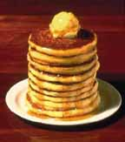
Stack
A stack is used to store elements where the Last element In is the First one Out (LIFO)
A common model of a stack is a plate or coin stacker
Plates are "pushed" onto to the top and “pooped” off the top

Slide 3
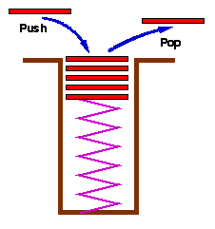
Stack

Slide 4
Stack
New elements are added or pushed onto the top of the stack
The first element to be removed or popped is taken from the top - the last one in

Slide 5
The Stack (Common Examples)
Plates on a cafeteria serving line
  This arrangement of trays is supported by a spring so that a person desiring a tray finds that only one is available at the surface of the tray counter
Top tray of pile
Stacked trays
Spring

Slide 6
Stack
Insertion
Deletion
Bottom Top

Slide 7
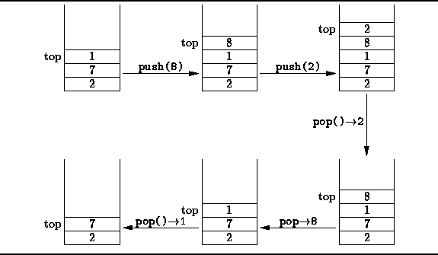
Stack

Slide 8
Stack Operations
A stack is generally implemented with only two principle operations
  Push adds an item to a stack
  Pop extracts the most recently pushed item from the stack
Other methods such as
  Top returns the item at the top without removing it
  Isempty determines whether the stack has anything in it

Slide 9
Stack Implementation
Static Implementation (Using arrays)
Dynamic Implementation (Using dynamic lists)

Slide 10
Stack Implementation Using Arrays
For the static implementation of stack an array will be used
This array will hold the stack elements
The top of a stack is represented by an integer type variable which contains the index of an array containing top element of a stack

Slide 11
Stack Implementation Using Arrays
4
4
4
top
4
3
2
1
0
4
4
5
3
3
top
3
3
4
3
4
2
2
top
2
9
2
9
2
9
Push 8
Push 7
Push 9
Push 4
Push 5
1
1
8
1
8
1
8
top
1
8
top
0
7
0
7
0
7
0
7
0
7
Empty stack
StackSize = 5
top = -1
top = StackSize – 1,
Stack is full,
We can’t push more elements.

Slide 12
Stack Implementation Using Arrays
push(element)
{
if (isfull())
cout<<“stack is full”;
else
Stack[++top] = element;
}

Slide 13
bool isfull()
{
If(top==size-1)
  Return true;
  Else
    Return false;
    }

Slide 14
Stack Implementation Using Arrays
4
3
2
1
0
top
4
5
4
4
4
4
3
4
top
3
4
3
3
3
2
9
2
9
top
2
9
2
2
Pop
Pop
Pop
Pop
Pop
1
8
1
8
1
8
1
8
1
top
0
7
0
7
0
7
0
7
top
0
7
Empty stack
top = -1
We can’t pop mpre
elements
top = StackSize – 1,
Stack is full,
We can’t push more elements.

Slide 15
Stack Implementation Using Arrays
pop( )
{
if (top == –1)
cout<<“stack is empty”;
else
return Stack[top--];
}

Slide 16
Stack Implementation Using Arrays
topElement() //returns the top element of stack //without removing it.
{
if (top == –1)
cout<<“stack is empty”;
else
return Stack[top];
}

Slide 17
Stack Implementation Using Arrays
isEmpty() //checks stack is empty or not
{
if (top == –1)
return true;
else
return false;
}

Slide 18
Stack Class
Class sta{
Public:
int *s;
int top, size;
sta() {
top==-1;
Size=10;
S=new int[size];
}
sta(int si) {
top==-1;
Size=si;
S=new int[size];
}
push(ele)
{
if (isfull())
cout<<“stack is full”;
else
s[++top] = ele;
}
Int pop( )
{
if (isempty())
cout<<“stack is empty”;
else
return s[top--];
}
bool isempty(){
if(top==-1)
return true;
else
return false;
}
bool isfull()
{------}
}
Int main()
{
Sta s, s1(6);
S1.push(4);
Cout<<s1.pop()

Slide 19
Applications of Stack

Slide 20
Applications of Stacks
String Reversing
Checking for balanced braces
Palindrogran
Memory Management
Expression Evaluation

Slide 21
1. String Reversing
Push each character on to a stack as it is read
When the line is finished, we then pop characters off the stack, and they will come off in the reverse order

Slide 22
2. Checking for Balanced Braces
A stack can be used to verify whether a program contains balanced braces
  An example of balanced braces
    abc{defg{ijk}{l{mn}}op}qr
  An example of unbalanced braces
    abc{def}}{ghij{kl}m

Slide 23
2. Checking for Balanced Braces
Requirements for balanced braces
  Each time you encounter a “}”, it matches an already encountered “{”
  When you reach the end of the string, you have matched each “{”

Slide 24
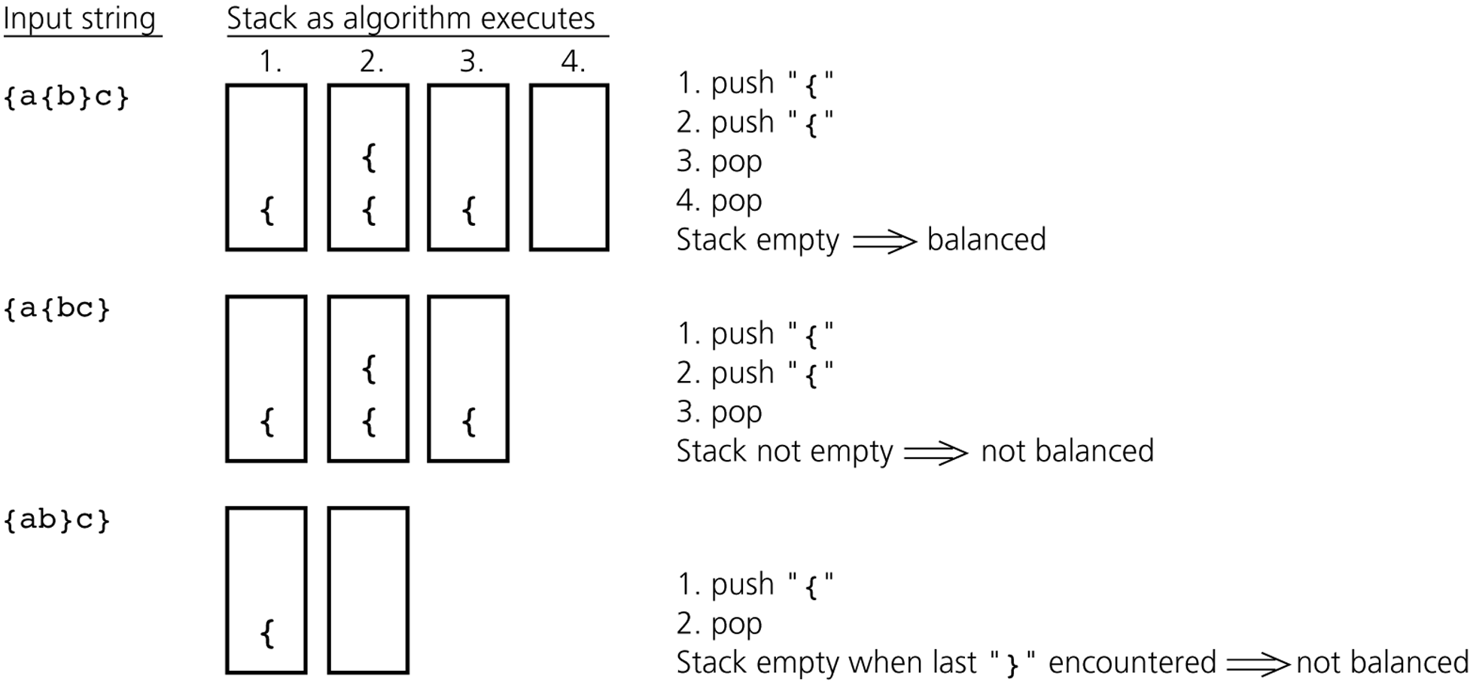
2. Checking for Balanced Braces

Slide 25
[{()}]
  [a-{b+(c/d)}]
  [{()}] - valid
  {[()]} - Invalid
  Priority order:
  [ { (
  { (

Slide 26
Invalid expressions
{ [ ( ) ] }
( { } )
( [ ] )

Slide 27
3. Palindrome
A Palindrome is a string that reads the same in either direction
  Examples: MALAYALAM
  Algorithm
  Scan the input string from left to right and push each character of input string onto a stack
  Form the reverse of the string by popping the characters and joining them together in the order that they come off the stack
  Compare the reversed string with the original. If they are the same, the original input string is a palindrome

Slide 28
A Legend
The Towers of Hanoi
In the great temple of Brahma in Benares, on a brass plate under the dome that marks the center of the world, there are 64 disks of pure gold that the priests carry one at a time between these diamond needles according to Brahma's immutable law: No disk may be placed on a smaller disk. In the begging of the world all 64 disks formed the Tower of Brahma on one needle. Now, however, the process of transfer of the tower from one needle to another is in mid course. When the last disk is finally in place, once again forming the Tower of Brahma but on a different needle, then will come the end of the world and all will turn to dust.

Slide 29

The Towers of Hanoi
A Stack-based Application
  GIVEN: three poles
  a set of discs on the first pole, discs of different sizes, the smallest discs at the top
  GOAL: move all the discs from the left pole to the right one.
  CONDITIONS: only one disc may be moved at a time.
  A disc can be placed either on an empty pole or on top of a larger disc.

Slide 30

Towers of Hanoi

Slide 31

Towers of Hanoi

Slide 32

Towers of Hanoi

Slide 33

Towers of Hanoi

Slide 34

Towers of Hanoi

Slide 35

Towers of Hanoi

Slide 36
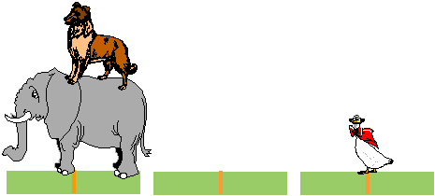
Towers of Hanoi

Slide 37
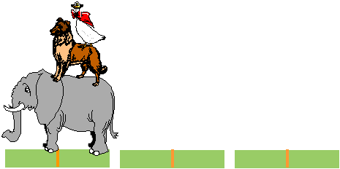
Towers of Hanoi

Slide 38


factorial function
The C++ equivalent of this definition:
int fac(int numb){
if(numb<=1)
return 1;
else
return numb * fac(numb-1);
}
recursion means that a function calls itself

Slide 39
factorial function
Assume the number typed is 3, that is, numb=3.
fac(3) :
  3 <= 1 ? No.
  fac(3) = 3 * fac(2)
  fac(2) :
    2 <= 1 ? No.
    fac(2) = 2 * fac(1)
    fac(1) :
      1 <= 1 ? Yes.
      return 1
int fac(int numb){
if(numb<=1)
return 1;
else
return numb * fac(numb-1);
}
    fac(2) = 2 * 1 = 2
    return fac(2)
  fac(3) = 3 * 2 = 6
  return fac(3)
fac(3) has the value 6

Slide 40
factorial function
For certain problems (such as the factorial function), a recursive solution often leads to short and elegant code. Compare the recursive solution with the iterative solution:
Iterative solution
int fac(int numb){
int product=1;
while(numb>1){
product *= numb;
numb--;
}
return product;
}
Recursive solution
int fac(int numb){
if(numb<=1)
return 1;
else
return numb*fac(numb-1);
}

Slide 41
Expression Evaluation Using Stack

Slide 42
Consider the same problems
Convert an infix expression into postfix expression. i.e.
  How a+b can be converted into ab+
And many more problems……..

Slide 43
Converting Infix expression to postfix
When an operand is read, it is immediately placed onto the output
When an operator or left parenthesis comes then save it in the stack initially stack is empty
If we see a right parenthesis, then we pop the stack, writing symbols until we encounter a (corresponding) left parenthesis, which is popped but not output
If we see any other symbol (‘+’, ‘*’, ‘(‘, etc) then we pop entries form the stack until we find an entry of lower priority. One exception is that we never remove a ‘(‘ from the stack except when processing a ‘)’
When the popping is done, we push the operand onto the stack
Finally, if we read the end of input, we pop the stack until it is empty, writing symbols onto the output

Slide 44
Converting Infix expression to postfix
Convert the following infix expression to postfix expression
a+b*c+(d*e+f)*g
First the symbol a is read, so it is passed through to the output
a
Then + is read and pushed onto the stack
output
+
stack
Next b is read and passed through to the output
ab
output
*
+
Next a * is read. The top entry on the operator stack has lower precedence than *, so nothing is output and * is put on the stack
stack

Slide 45
Converting Infix expression to postfix
Converting the following infix expression to postfix expression
a+b*c+(d*e+f)*g
Next c is read and output
abc
output
The next symbol is a +. Checking the stack, we find that priority of stack top symbol * is higher than + . So we pop a * and place it on the output, Pop the other +, which is not of lower but equal priority, and then push +
*
+
abc*+
+
output
stack
stack

Slide 46
Converting Infix expression to postfix
Converting the following infix expression to postfix expression
a+b*c+(d*e+f)*g
The next symbol read is ‘(‘, which, being of highest precedence, is placed on the stack
(
+
stack
Then d is read and output
abc*+d
output

Slide 47
Converting Infix expression to postfix
Converting the following infix expression to postfix expression.
a+b*c+(d*e+f)*g
We continue by reading a *. Since open parenthesis do not get removed except when a closed parenthesis is being processed, there is no output and we push * in stack
*
(
+
stack
Next, e is read and output is
abc*+de
output

Slide 48
Converting Infix expression to postfix
Converting the following infix expression to postfix expression.
a+b*c+(d*e+f)*g
The next symbol read is a +, since priority of stack top value is higher so we pop * and push +
+
(
+
abc*+de*
output
stack
Now we read f and output f
abc*+de*f
output

Slide 49
Converting Infix expression to postfix
Converting the following infix expression to postfix expression.
a+b*c+(d*e+f)*g
Now we read a ‘)’, so the stack is emptied back to the ‘(‘, we output a +
abc*+de*f+
+
output
stack
We read a * next; it is pushed onto the stack
*
+
stack
Now, g is read and output
abc*+de*f+g
output

Slide 50
Converting Infix expression to postfix
Converting the following infix expression to postfix expression.
a+b*c+(d*e+f)*g
*
+
stack
The input is now empty, so pop output symbols from the stack until it is empty
abc*+de*f+g*+
output
stack

Slide 51
Consider the same problems
Evaluate a postfix expression / postfix calculator.
  A postfix expression is a mathematical expression in which operators appears at the right side of an operand. E.g.
  ab+ is equivalent to a+b,
  ab+c- is equivalent to a+b-c
  ab+cd*- is equivalent to a+b-c*d

Slide 52
Evaluating Postfix Expression
Postfix Expression Evaluation
  When a number is seen, it is pushed onto the stack
  When an operator is seen, then pop two elements from stack and push the result onto the stack
Now we evaluate the following postfix expression
6 5 2 3 + 8 * + 3 + *
3
2
5
6
The first four are placed on the stack. The resulting stack is
stack

Slide 53
Evaluating Postfix Expression
evaluating the following postfix expression.
6 5 2 3 + 8 * + 3 + *
3
2
5
6
stack
5
5
6
Next a + is read, so 3 and 2 are popped from the stack and their sum 5 is pushed
stack

Slide 54
Evaluating Postfix Expression
evaluating the following postfix expression.
6 5 2 3 + 8 * + 3 + *
5
5
6
stack
8
5
5
6
Next 8 is read and pushed
stack

Slide 55
Evaluating Postfix Expression
evaluating the following postfix expression.
6 5 2 3 + 8 * + 3 + *
8
5
5
6
stack
40
5
6
Next a * is seen so 8 and 5 are popped as 8 * 5 = 40 is pushed
stack

Slide 56
Evaluating Postfix Expression
evaluating the following postfix expression.
6 5 2 3 + 8 * + 3 + *
40
5
6
stack
Next a + is read so 40 and 5 are popped and 40 + 5 = 45 is pushed
45
6
stack

Slide 57
Evaluating Postfix Expression
evaluating the following postfix expression.
6 5 2 3 + 8 * + 3 + *
45
6
stack
Now 3 is pushed
3
45
6
stack

Slide 58
Evaluating Postfix Expression
evaluating the following postfix expression.
6 5 2 3 + 8 * + 3 + *
3
45
6
stack
Next symbol is + so pops 3 and 45 and pushes 45 + 3 = 48, so push 48 in stack
48
6
stack

Slide 59
Evaluating Postfix Expression
evaluating the following postfix expression.
6 5 2 3 + 8 * + 3 + *
48
6
stack
Finally a * is seen and 48 and 6 are popped, the result 6 * 48 = 288 is pushed
As there is no input, so pop the stack and we get the result
288
stack

Slide 60
((())) valid
((()) Invalid
(())) Invalid
(a-(b+(c-d))) valid if(arr[i]==‘(‘) -> push(arr[i])
((()) Invalid
(())) Invalid

Slide 61
[{()}] valid
{[()]} invalid
([{}]) invalid
[a-{b+(c-d)}] valid if(arr[i]==‘(‘) -> push(arr[i])
{a-[b+(c-d)]} Invalid

Slide 62
Class Exercise:
Convert the following infix expression to postfix expression:
7+(5-3*6)+8/2+9 = 7

Slide 63
Assignment-2
Palindrome checking by Stack of Array, Singly and doubly linked list of Stack
Checking for Single type balanced braces
((()))
3. Checking for Multiple balanced braces
[{()}]
Write a C language code to convert the infix expression to postfix expression
Write the C++ language code to evaluate the postfix expression.

Slide 64
Reference:
Saif-ur-Rehman khan, COMSATS
Dr.Abdul Qadir, Maju university
Huamin Qu, Department of Computer Science and Engineering, HKUST
DataStructures in C++ by NEL-DEL

